Slide 1
7C’S OF DIGITAL LITERACY

Slide 2
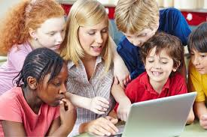
The 7 Cs of Digital Literacy refer to key skills that help people navigate and use technology effectively in a digital world. These skills are essential for interacting with digital tools, understanding information, and communicating in a digital environment.

Slide 3

Critical thinking
The ability to solve problems and reason effectively means being able to think clearly, understand challenges, and find solutions. In today’s world, many jobs need people who can think flexibly and analyze situations from different angles. This skill is important because it helps you break down complex problems and come up with smart solutions by using information from various sources.

Slide 4

CREATIVITY
Working creatively with others means teaming up with people to share ideas and work together to come up with new and better ways of doing things. When you put your heads together, you can come up with even better solutions than if you worked alone.

Slide 5
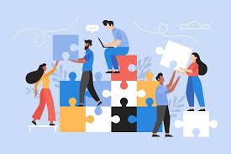
COLLABORATION
The ability to cooperate means being able to work well with others. It involves being willing to listen, share ideas, and help each other out.
Building community means creating a strong, supportive group where everyone feels included and valued.

Slide 6
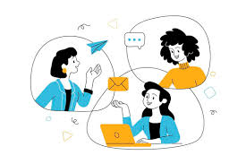
COMMUNICATION
Being able to communicate clearly and effectively means being able to share your ideas in a way that others understand, whether you’re talking, writing, or using other forms of communication. In today’s world, people come from different backgrounds, so it’s important to communicate well with all kinds of people.

Slide 7

ICT LITERACY
Today, businesses and organizations depend a lot on technology to do their work, whether it’s for communicating, managing information, or making products. Knowing how to use technology properly will not only help you do your job better but also make you more successful in your career.

Slide 8
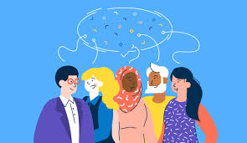
CROSS CULTURAL UNDERSTANDING
As the world becomes more connected, whether online or in-person, it’s increasingly important to know how to work well with people from different cultures and backgrounds. This skill helps create better teamwork and more innovative solutions, especially in today’s international and diverse work environments.

Slide 9

CAREER AND SELF LEARNING RELIANCE
Because the world is constantly changing and full of surprises, it’s important to keep learning new things and be flexible enough to handle whatever comes next. This helps you stay strong and prepared for future opportunities and challenges in your life and career.

Slide 10

CHALLENGES OF DIGITAL LITERACY

Slide 11

Not everyone has adequate access to digital devices and the internet. In many areas, especially in rural and remote regions, technological infrastructure is still very limited.
Many people still do not understand how to use technology correctly and safely. Knowledge about using digital devices, applications, and the internet is still limited, making many vulnerable to fraud and cyber threats.

Slide 12

Cyber threats such as online fraud, identity theft, and malware attacks are becoming more common. Many internet users are unaware of the importance of digital security, making them vulnerable to cyber-attacks.
Many internet users do not yet understand digital ethics, such as the importance of protecting others' privacy, respecting copyrights, and behaving politely online.
Digital technology continues to evolve rapidly, and not everyone can keep up with these developments.

